Slide 1
learn how to think algorithmically

Slide 2
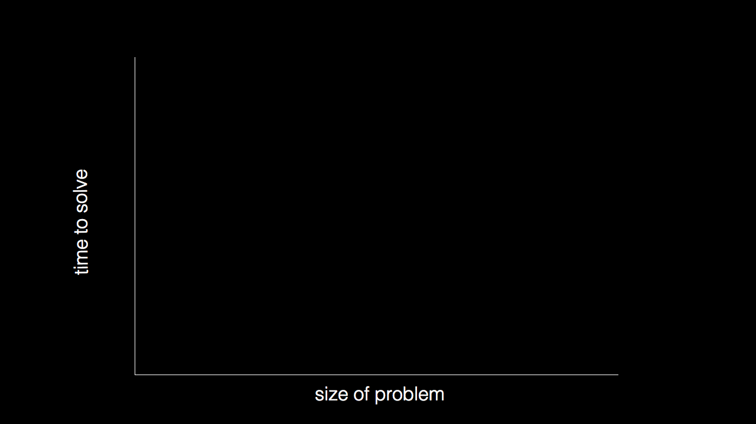

Slide 3
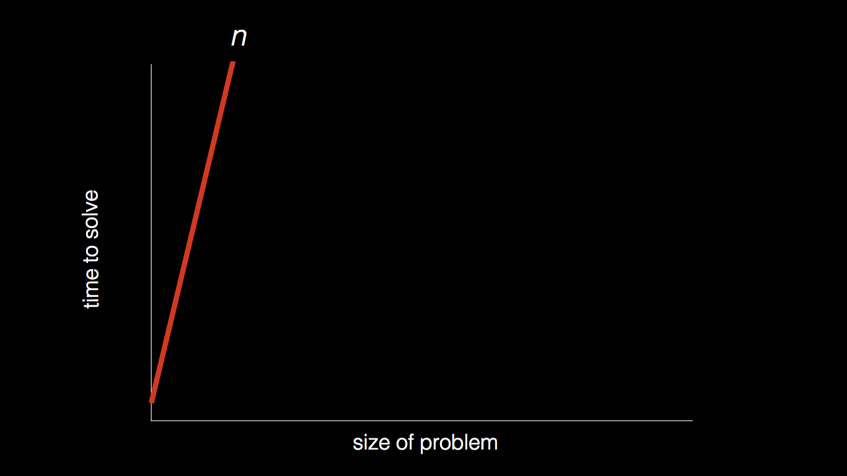
n

Slide 4
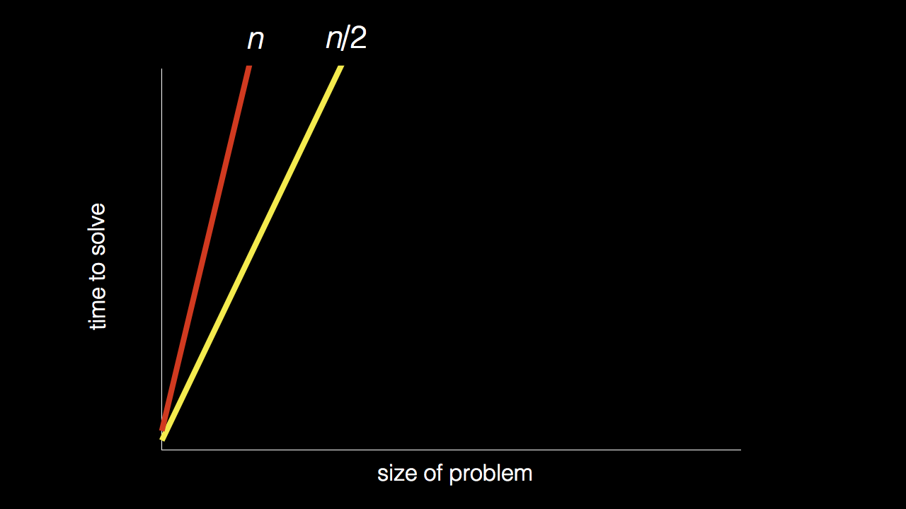
n
n/2

Slide 5
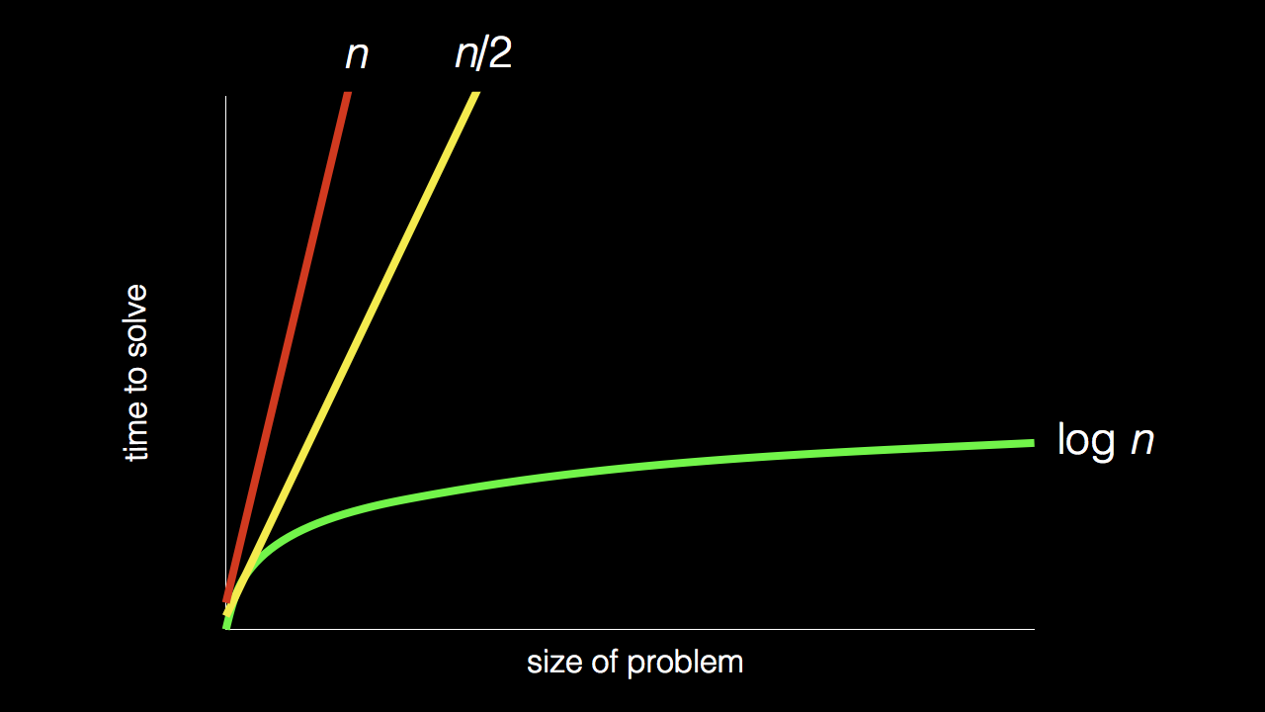
n
n/2
log₂ n

Slide 6


Slide 7
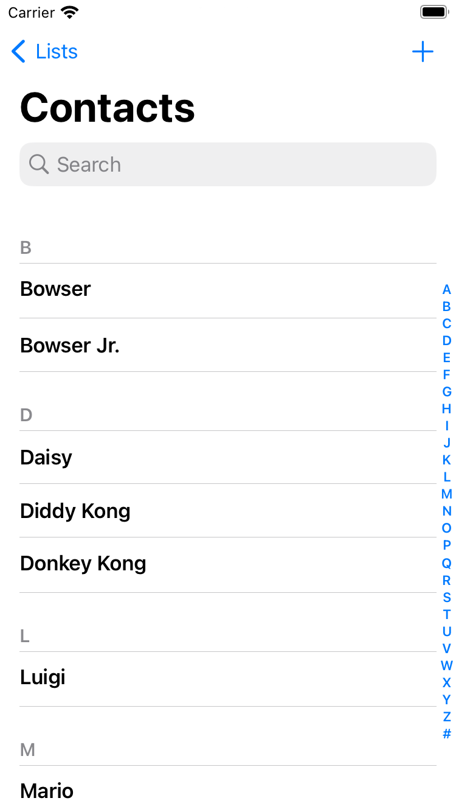

Slide 8
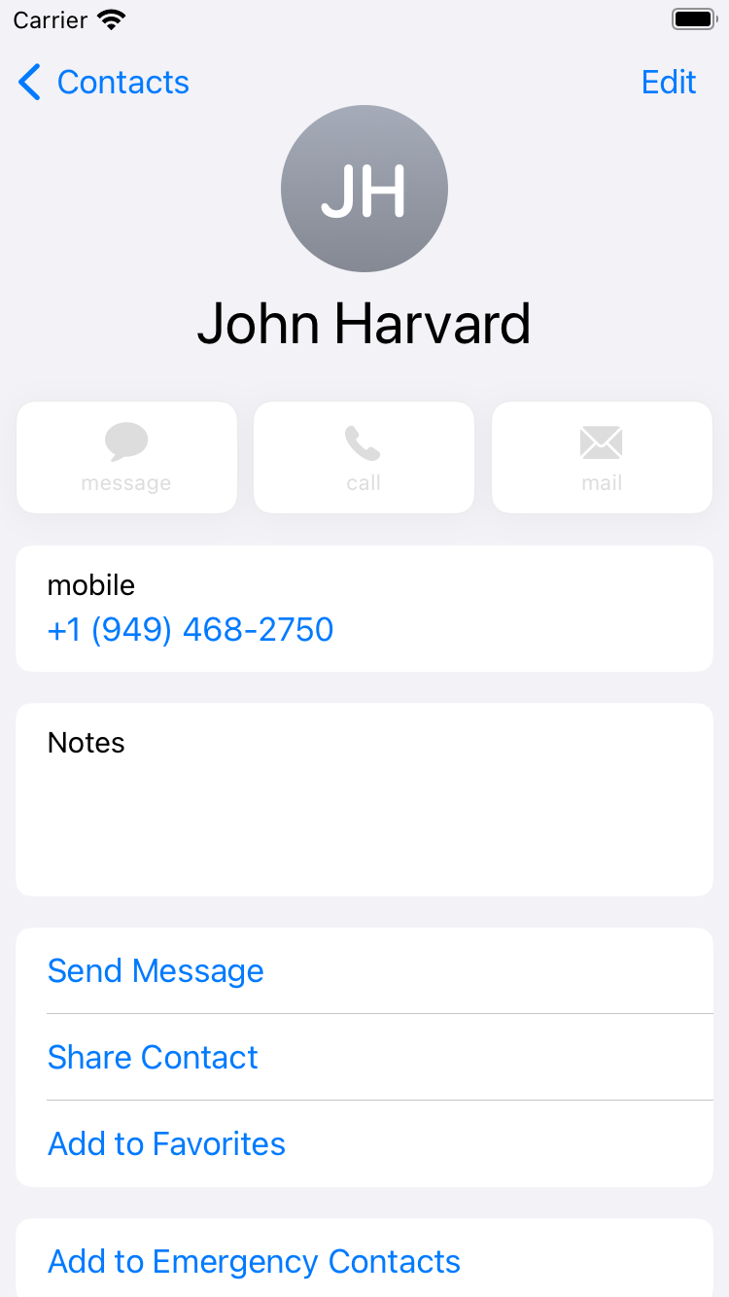

Slide 9
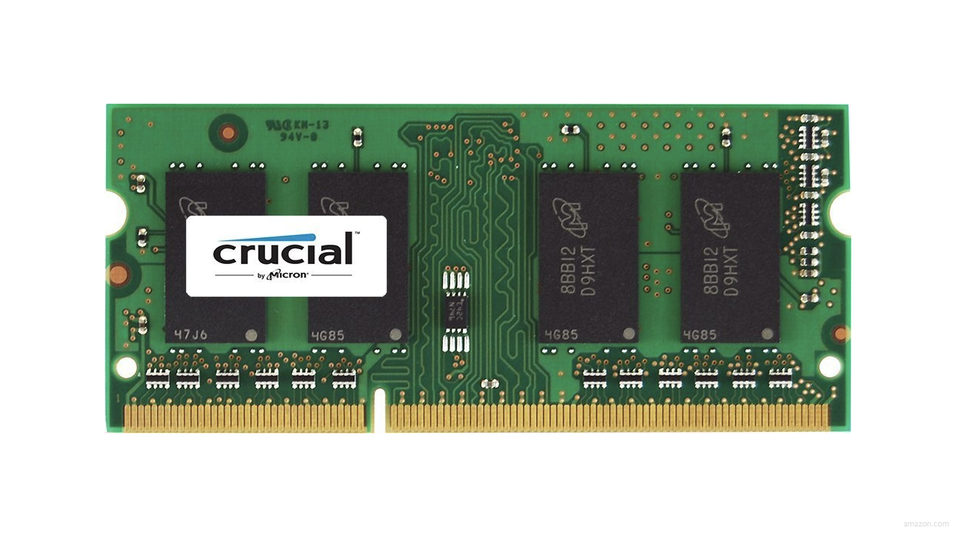

Slide 13
 | 1 | 5 | 10 | 20 | 50 | 100 | 500

Slide 15
 | [0] | [1] | [2] | [3] | [4] | [5] | [6]

Slide 16
 | [0] | [1] | [2] | [3] | [4] | [5] | [6]

Slide 17
searching

Slide 18
input →
→ output

Slide 19
→
→ output

Slide 20

→
→ bool

Slide 21
algorithm

Slide 22


Slide 23
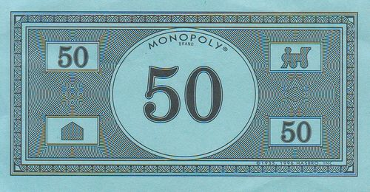

Slide 24
linear search

Slide 25
For each door from left to right
If 50 is behind door
Return true
Return false

Slide 26
For each door from left to right
If 50 is behind door
Return true
Else
Return false

Slide 27
For each door from left to right
If 50 is behind door
Return true
Return false

Slide 28
For i from 0 to n-1
If 50 is behind doors[i]
Return true
Return false

Slide 30
binary search

Slide 31
If 50 is behind middle door
Return true
Else if 50 < middle door
Search left half
Else if 50 > middle door
Search right half

Slide 32
If no doors left
If 50 is behind middle door
Return true
Else if 50 < middle door
Search left half
Else if 50 > middle door
Search right half

Slide 33
If no doors left
Return false
If 50 is behind middle door
Return true
Else if 50 < middle door
Search left half
Else if 50 > middle door
Search right half

Slide 34
If no doors left
Return false
If 50 is behind doors[middle]
Return true
Else if 50 < doors[middle]
Search doors[0] through doors[middle - 1]
Else if 50 > doors[middle]
Search doors[middle + 1] through doors[n - 1]

